Slide 1
CST For Unilateral Magnet & RF Probe Simulation
Devin Morin
August 6, 2020

Slide 2
Introduction
Using CST (computer simulation technology) to simulate and optimize magnet arrays for a new unilateral magnet.
One can optimize for a parameter and achieve an optimal result.
Using CST to simulate surface current effects on B1 magnetic field.

Slide 3
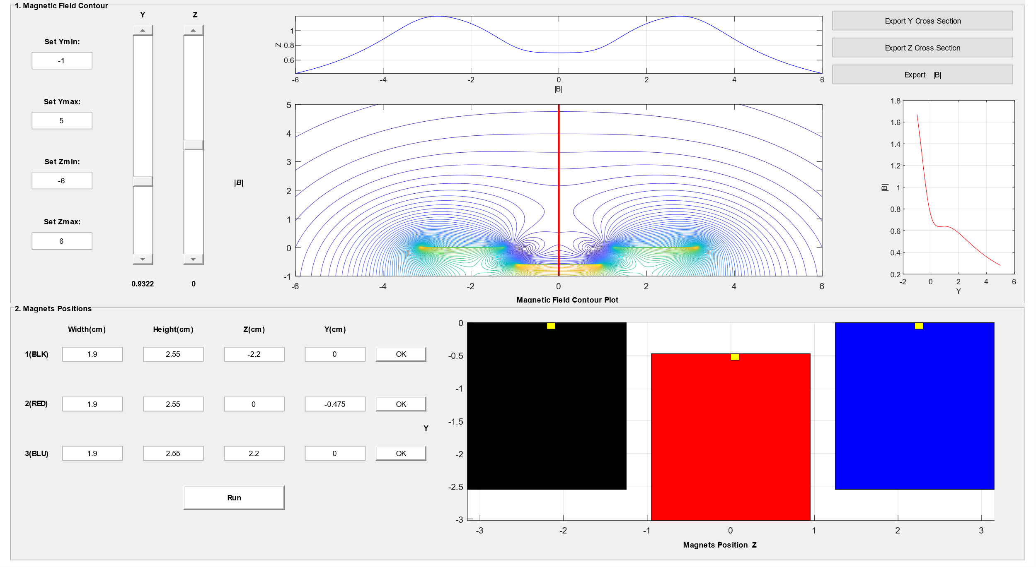
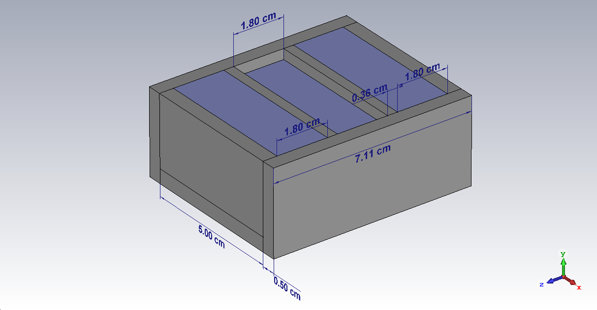
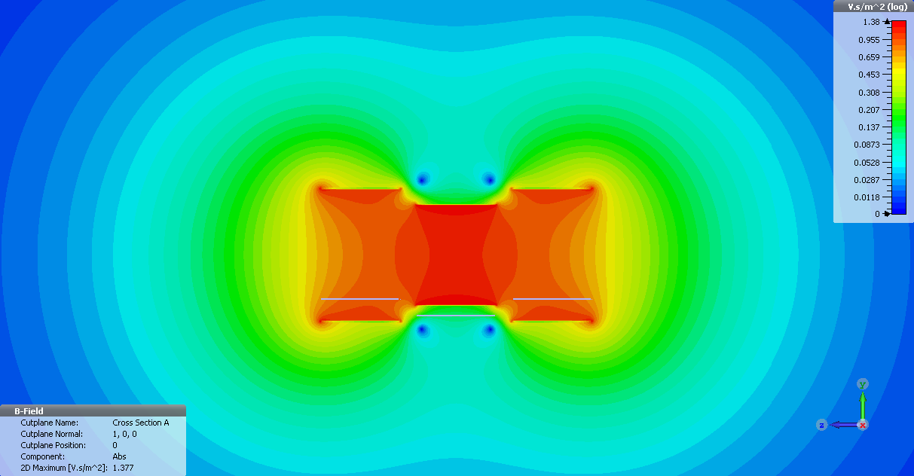
MatLab VS CST
Simple and easy to use
Assumes infinite sheet of current
3D visualization
Built in optimization and force calculations
Proper simulation of fringe fields

Slide 4
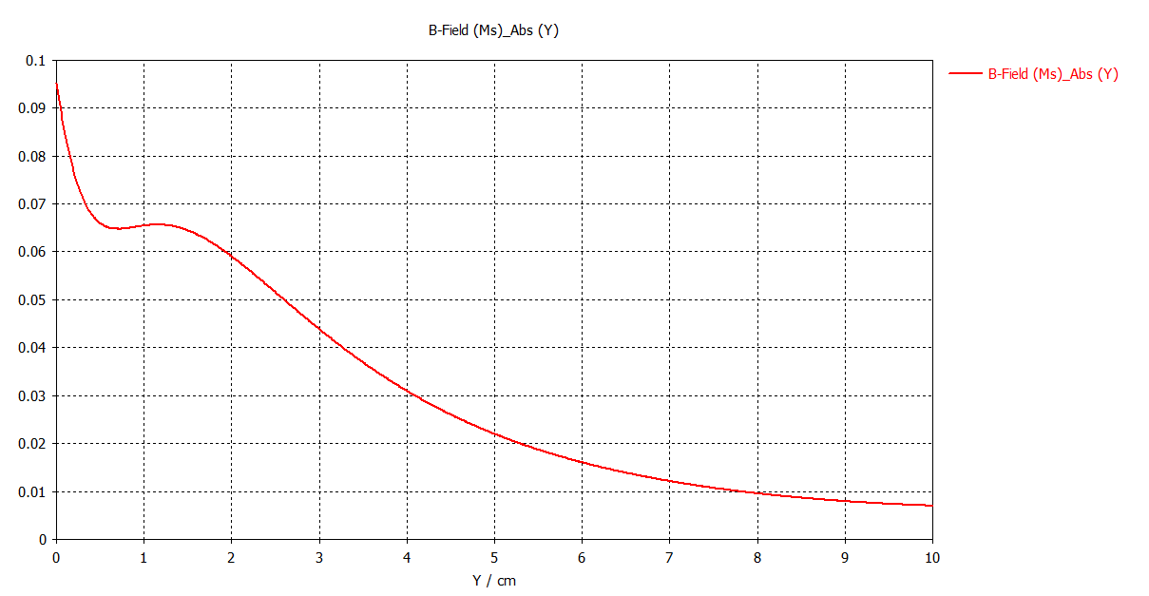
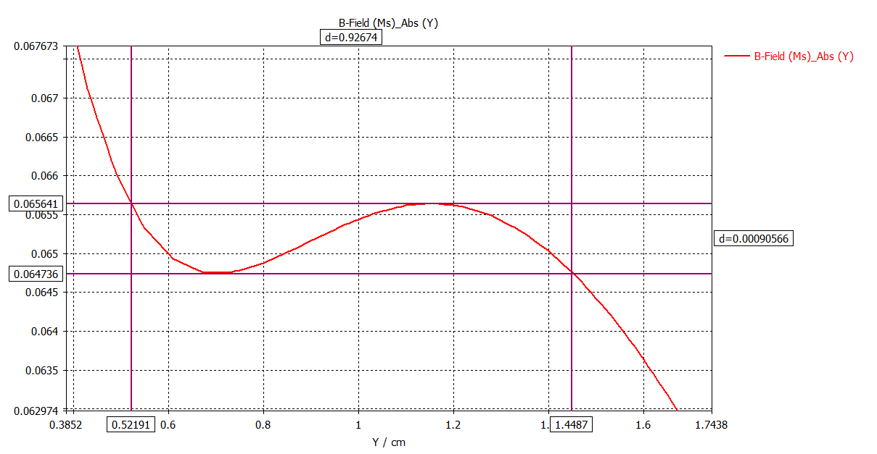
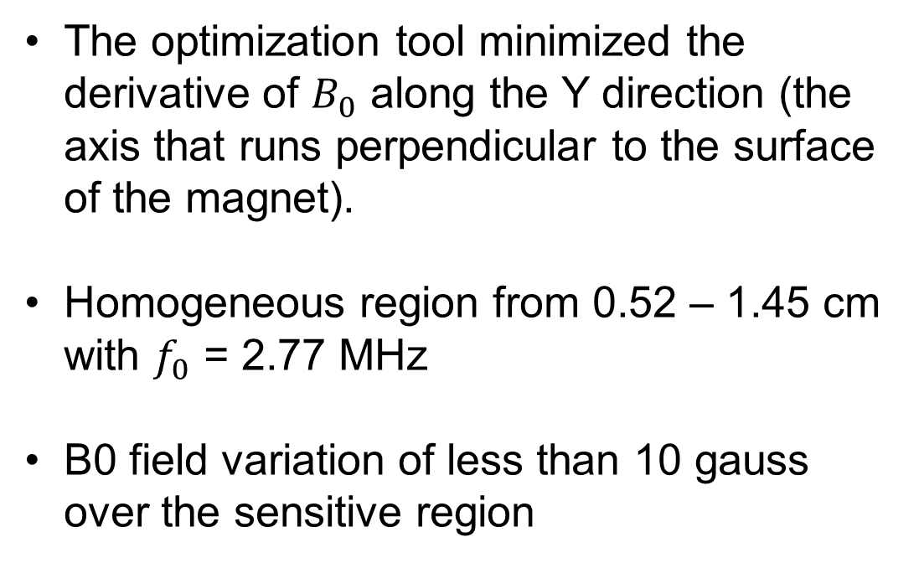
CST Optimization
The optimization tool minimized the derivative of $B_{0}$ along the Y direction (the axis that runs perpendicular to the surface of the magnet).
Homogeneous region from 0.52 – 1.45 cm with $f_{0}$ = 2.77 MHz
B0 field variation of less than 10 gauss over the sensitive region

Slide 5
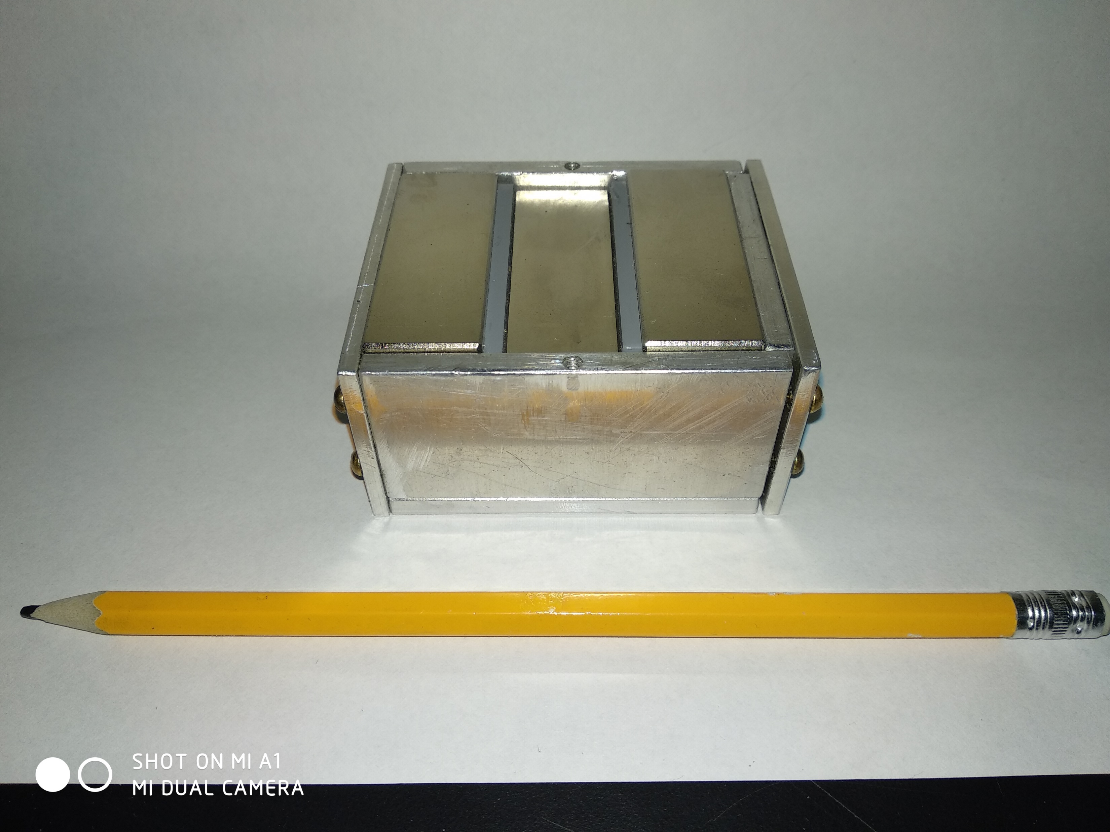
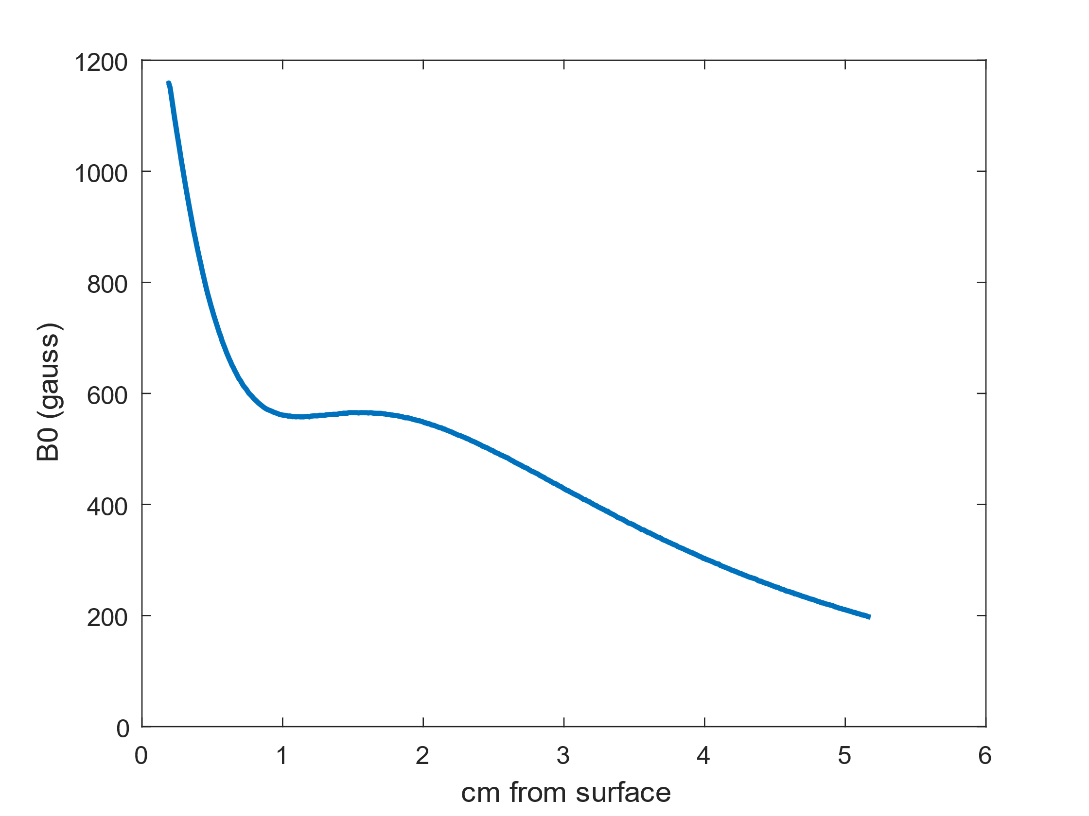
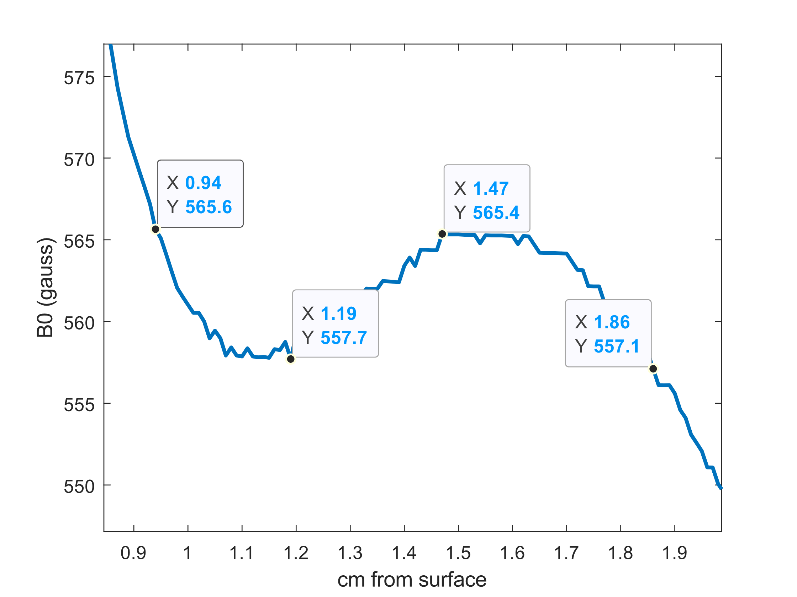
Experimental Results
Sensitive region is shifted
Magnitude of B1 field has decreased compared to simulation
This is maybe due to an incorrect remanence
Sensitive region from 0.94 – 1.86 cm with less than 8 gauss variation.

Slide 6
CST for RF Simulation

Slide 7
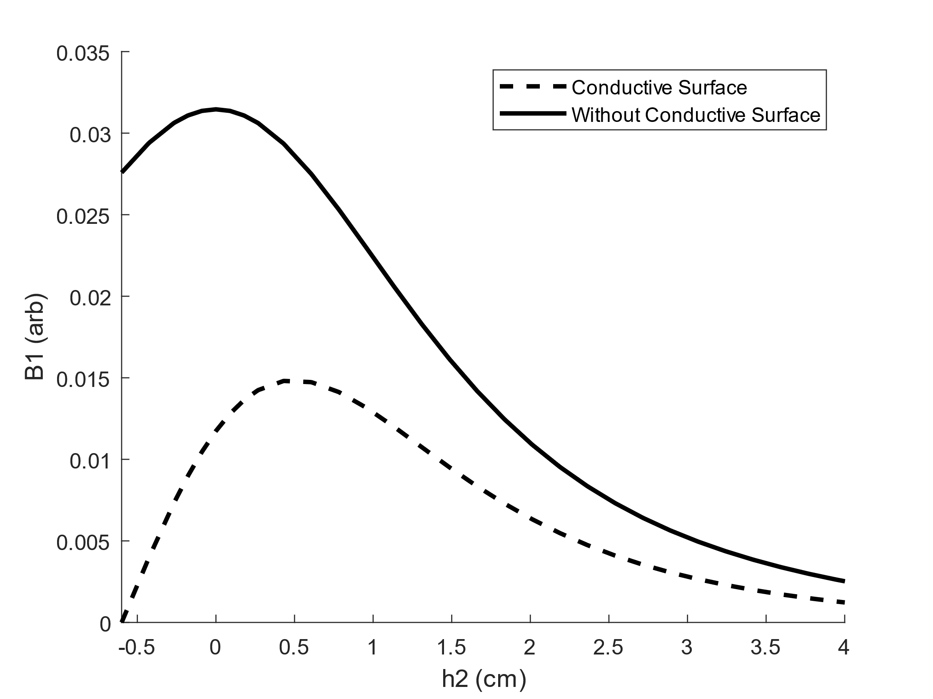
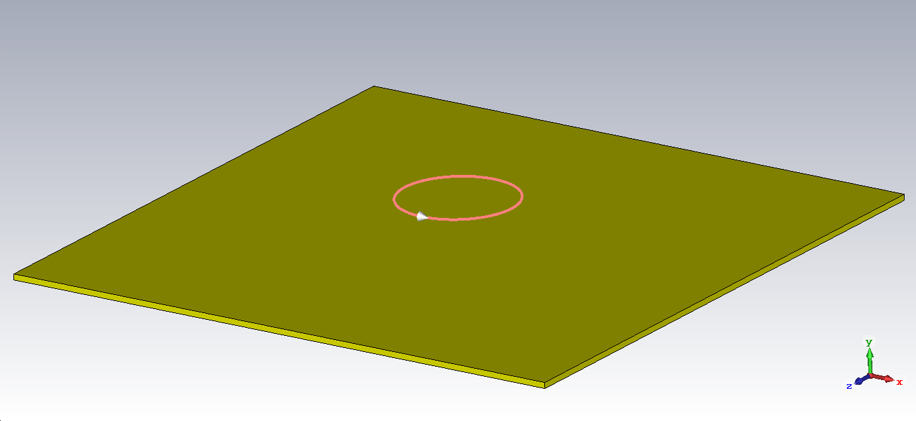
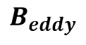
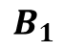
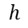
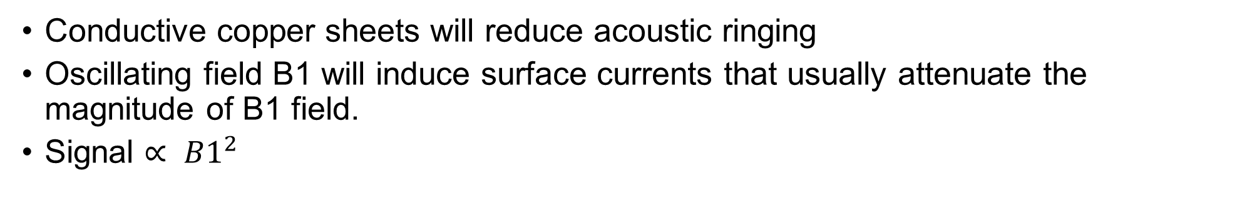
Surface Currents
Conductive copper sheets will reduce acoustic ringing
Oscillating field B1 will induce surface currents that usually attenuate the magnitude of B1 field.
Signal $∝ B1^{2}$
Nature abhors a change in flux!
$$B_{1}$$
$$h$$
$$B_{eddy}$$

Slide 8
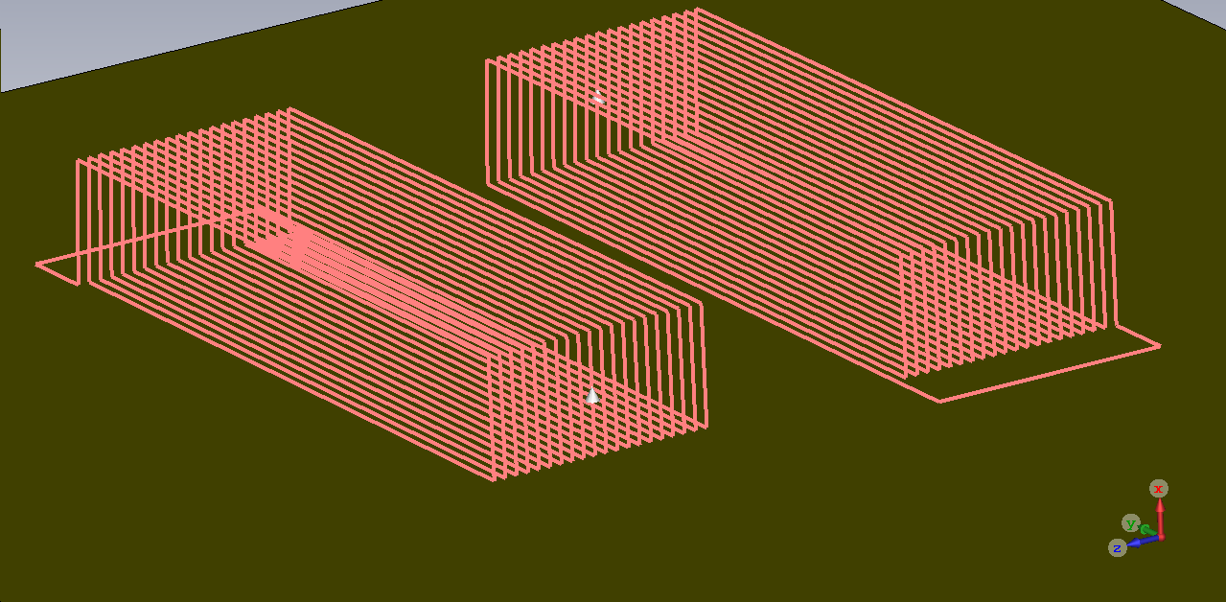
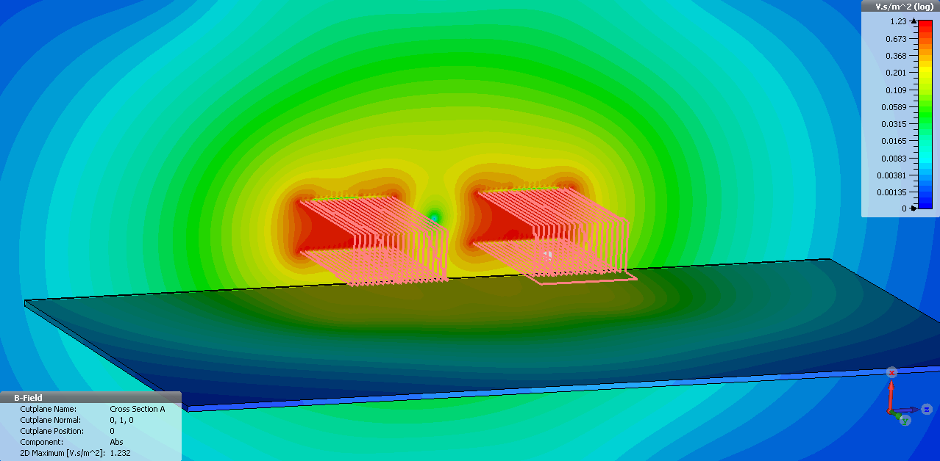
UC Davis Design
Counter-wound coil design that can use surface currents to our advantage
Utilizing the region above the center of the two coils
One wound clockwise, the other wound counter-clockwise

Slide 9
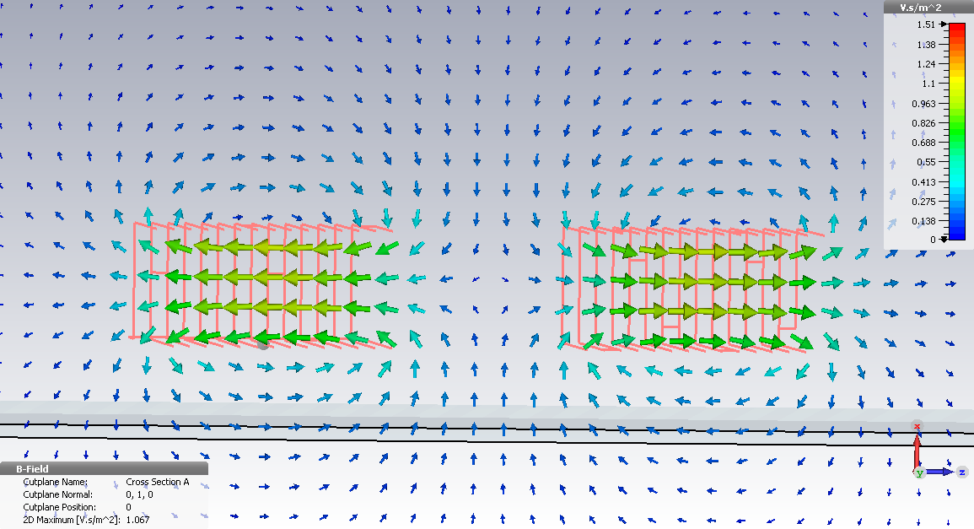
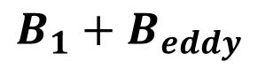
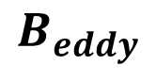
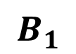
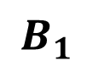
$$B_{1}$$
$$B_{1}+B_{eddy}$$
$$B_{1}$$
$$B_{eddy}$$

Slide 10
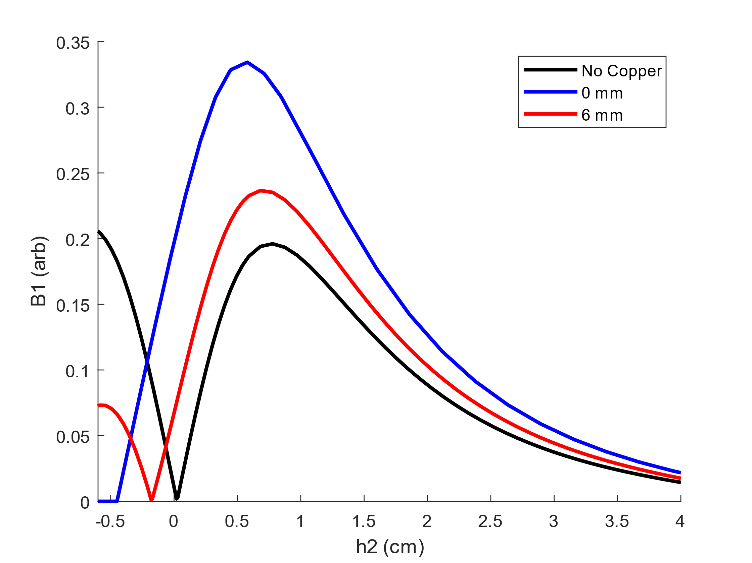
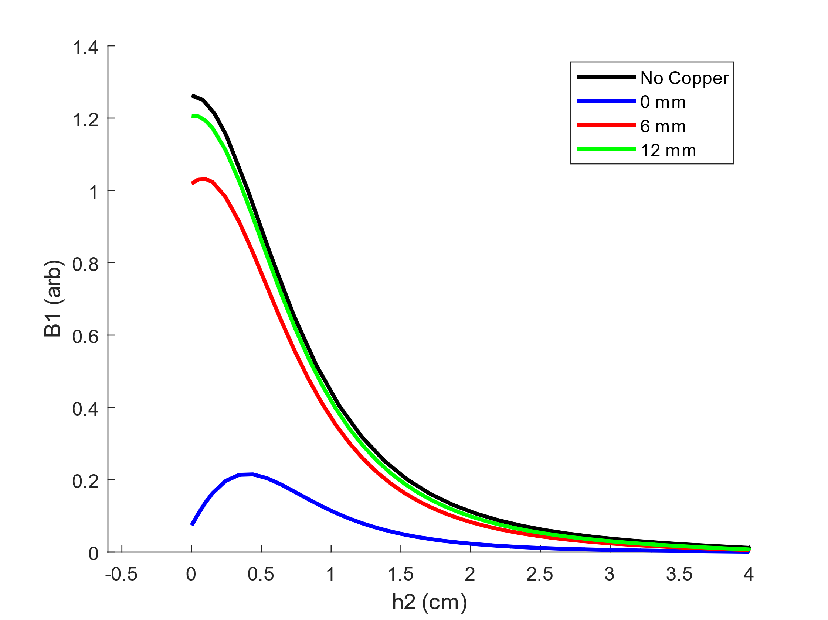
Surface Loop VS Counter-Wound
Surface Loop
Counter-Wound
B1 is amplified by surface currents
Utilizing a low field region compared to within the coil
As the coil is brought closer to the copper sheet, B1 increases.
Sample region
Best case scenario
Worst case scenario
Counter-wound design is practically equivalent to the surface loop in the worst-case scenario!

Slide 11
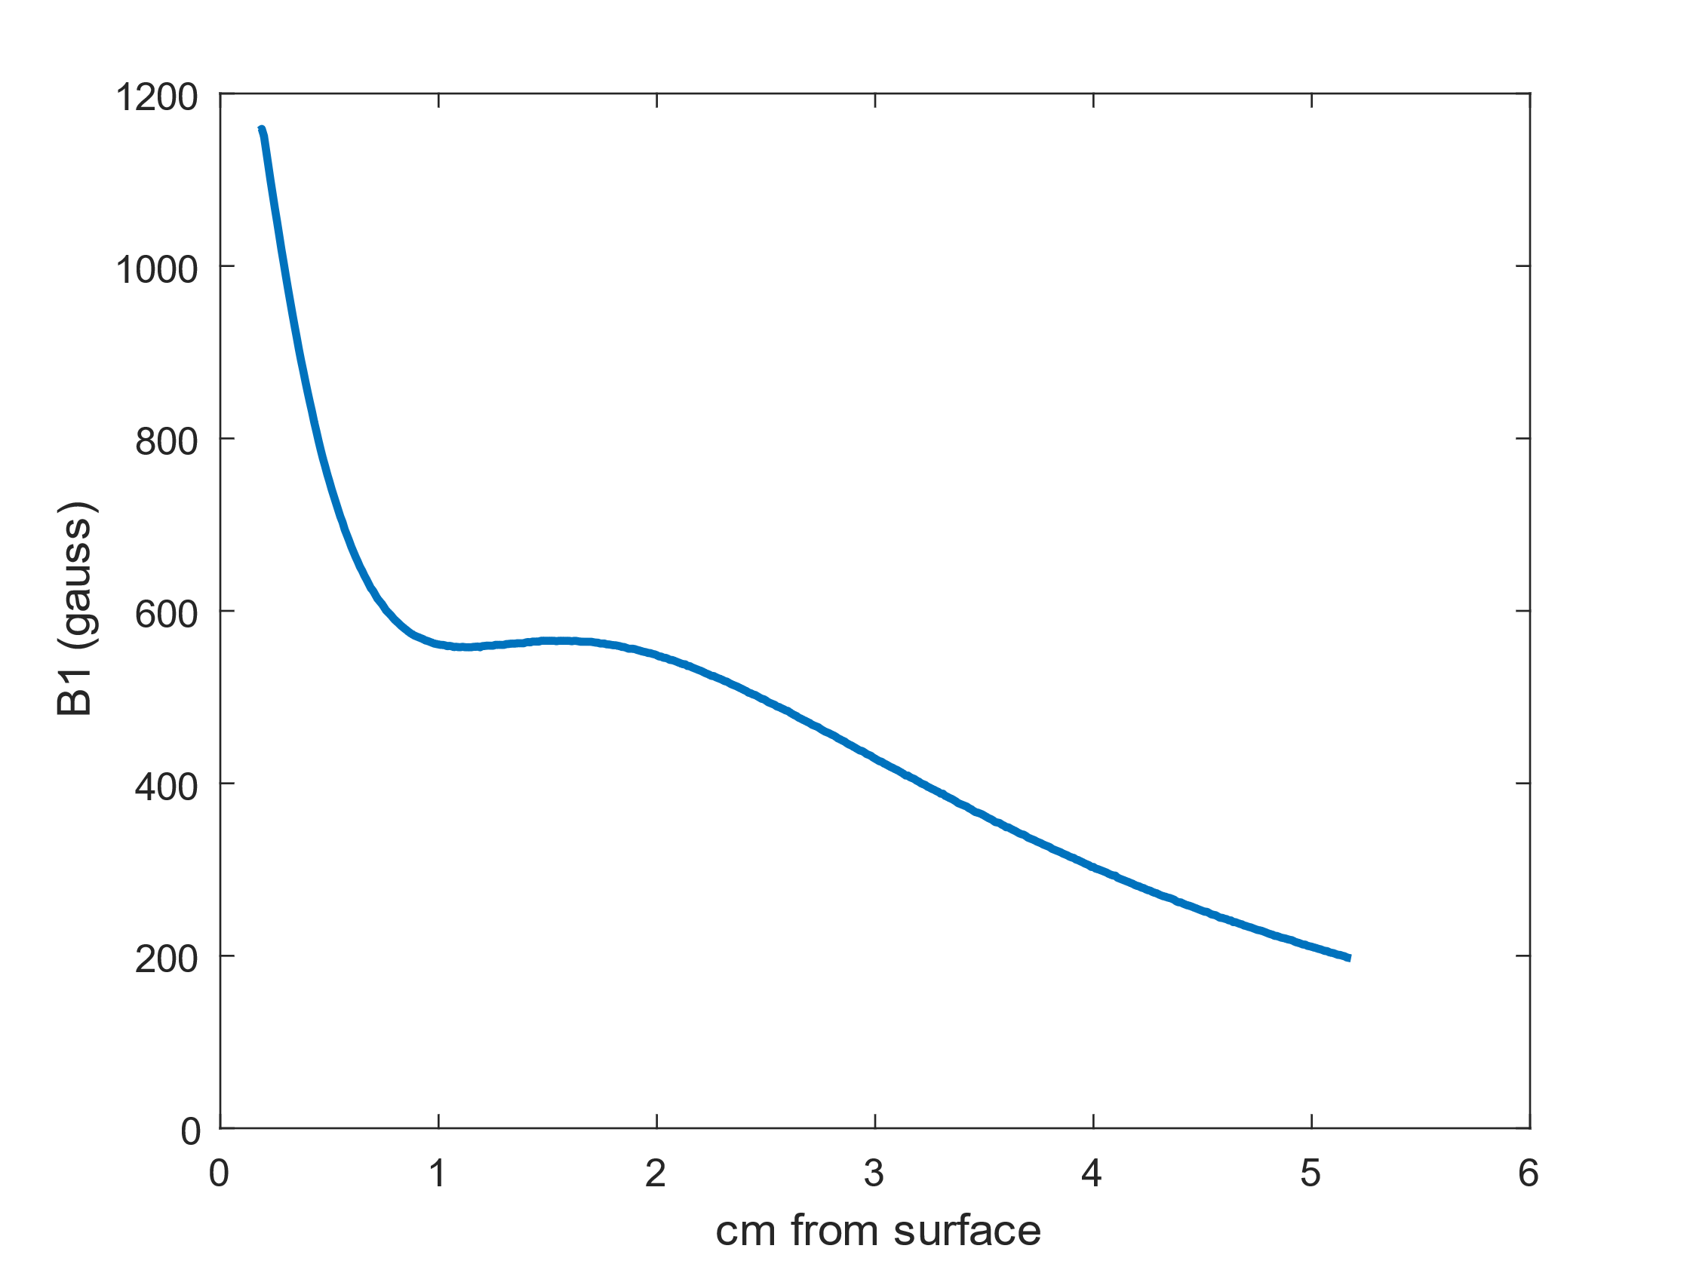
CST is a wonderful tool with many functionalities!
-Optimization
-Force Analysis
-3D Visualization
Homogeneous spot magnet construction
RF exploration
Conclusion

Slide 12

Acknowledgements
I would like to thank Bruce Balcom and Andres for all the help.
This work was supported by Mitacs through the Mitacs Research Training Award.

